Slide 1

IBM Transformation Advisor

Slide 2
IBM Accelerates your Cloud Adoption Journey
Analyze for Insights
IBM
Cloud Private
WAS
MQ
DB2
IIB
Portal
---
IBM
Public Cloud
WebLogic
JBoss
---
Notes:
Start with IBM Transformation Advisor to understand your inventory and to select the best entry point into your modernization journey.
Deliver value at each step of the journey
Outcomes are accelerated as you progress thru the journey
GET FIRST RESULTS IN WEEKS
Containerize the monolith to Reduce costs, simplify operations
Expose on-prem assets with APIs. Build APIs for your legacy assets that will not move to the cloud
Refactor into macroservices. Break down monoliths into deployable components
Add microservices Innovate incrementally, establish success early
Strangle the monolith Sunset the monolith incrementally

Slide 3
Garage Services for Application Modernization
Get a functional private cloud
Move application to cloud: Your developers will begin learning the IBM Cloud Garage Method by engaging in experiential learning as you work side-by-side with IBM SMEs to modernize applications
Learn the best tools and techniques to operate the newly modernized cloud application including an analysis of current operations, runbook review, and management dashboards
Using IBM’s Cloud Transformation Advisor tool , understand the applications in the environment, components, technology stack, functional and non-functional, dependencies and processes
Prioritize candidates (based on assessment) for immediate migration based on application information, value to the business and assessed complexity
Discover & Assess
You get:
A high level assessment of your overall application portfolio w.r.t readiness for modernization
Application Modernization
You get:
IBM Cloud Private (ICP ) + DevOps toolchain setup in non-prod environment with Minimum Viable Product for migrating containerized apps to ICP ( may include some re-factoring and/or re-platforming ).
Modernize & Operationalize
Competency & Deep Skills
Enablement Choices : Mix and match one week of training, choose from offerings:
Option 1: ICP BootCamp
Option 2 : Management and Ops enablement
Option 3 : Cloud Native App Dev
You get:
Choice of enablement based on your skills transformation needs

Slide 4
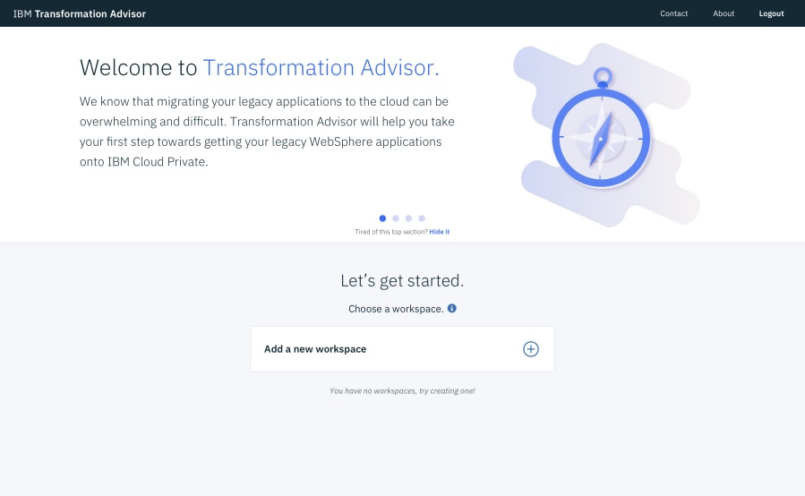
IBM Transformation Advisor
Collects information about your existing WebSphere Environment and Applications, combines that with rules and insights gained from years of working with WebSphere and WebSphere applications, and provides recommendations for your cloud journey
CHALLENGES ADDRESSED
Leveraging existing application logic
Need to accelerate application development and maintenance
Monolithic applications that are complex and tightly coupled
BENEFITS
Included and deployed on IBM Cloud Private
Introspects existing WebSphere Deployments
Provides recommendations, guidance and artifacts for deployment in Liberty containers and Kubernetes clouds
https://developer.ibm.com/app-modernization/

Slide 5

IBM Transformation Advisor insightful recommendations to accelerate your journey

Slide 6
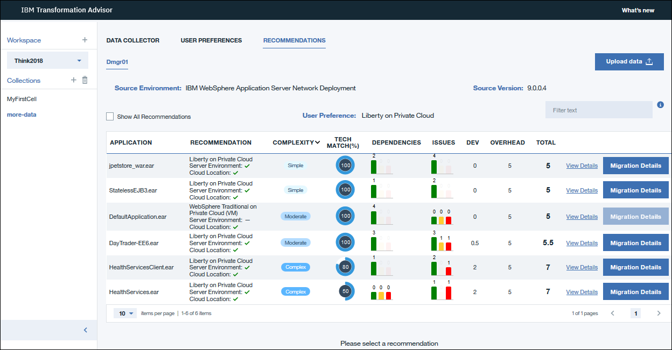
IBM Transformation Advisor
Creates application inventory, assesses modernization effort and provides insights and guidance …
Simple:
No code changes
Moderate:
Some refactoring needed
Complex:
May decide to run in WAS in VMs before re-engineering

Slide 7
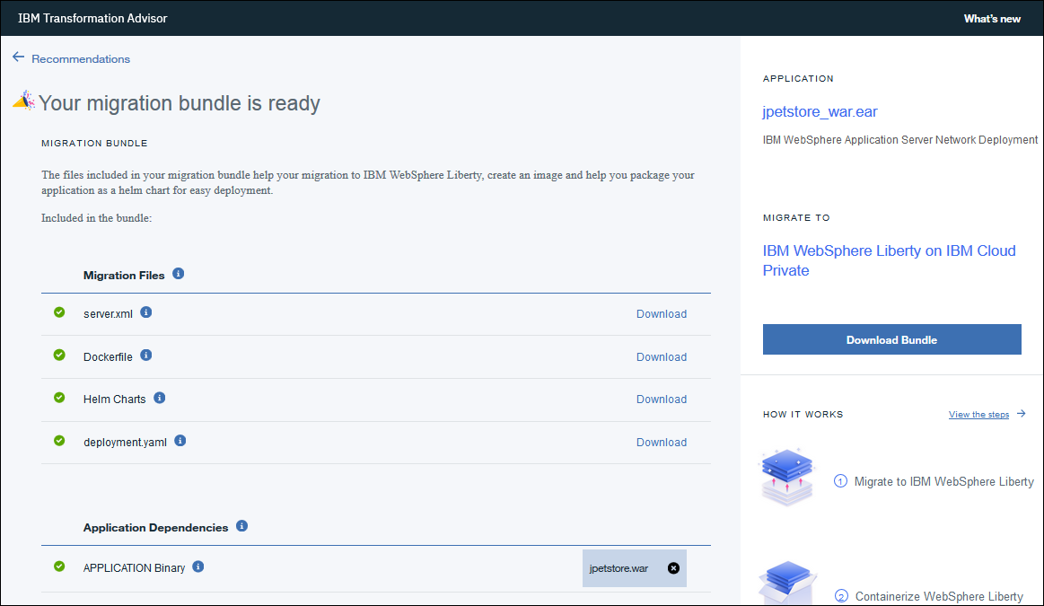
IBM Transformation Advisor
.. and accelerates modernization with customized Liberty and IBM Cloud deployment artifacts
Move to Liberty
Containerize and deploy

Slide 8
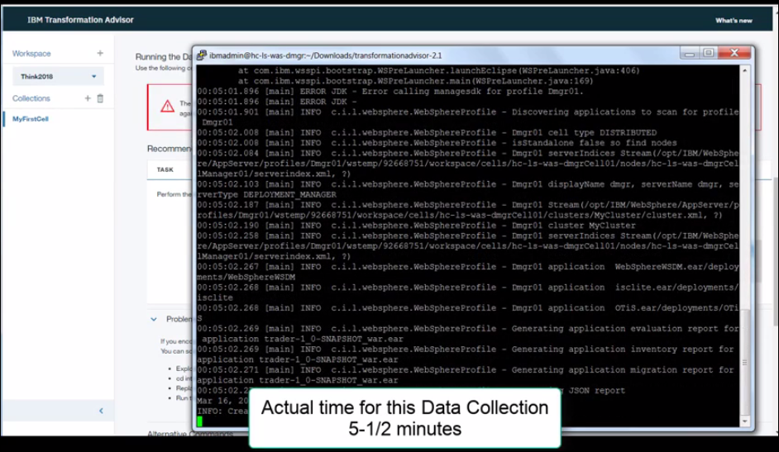
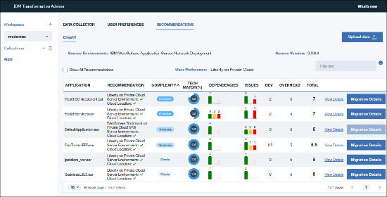
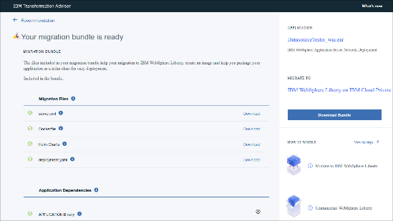
How it works
Data Collector is run against existing WebSphere system environment to gather information about WebSphere and the applications deployed there
Utilizes enhanced WAS binary scanner and configuration migration tools and provides recommendations and insights Applies rules related to the target cloud, the applications’ technology needs and dependencies, best practices for container and cloud deployments, etc.
Generates customized Liberty server.xml, Dockerfile, deployment.yaml and Helm charts for IBM cloud deployments
Notes:
Start with WAS based applications and use its dependencies to drive adoption of other IBM Software on IBM Cloud

Slide 9

Demo

Slide 10
References
IBM Transformation Advisor - https://developer.ibm.com/app-modernization/
Microclimate - https://www.ibm.com/us-en/marketplace/microclimate
WebSphere Liberty - http://wasdev.net/
IBM Cloud Automation Manager (CAM) - https://developer.ibm.com/cloudautomation/
Free online Garage Method Courses - https://www.ibm.com/cloud/garage/content/course/websphere-on-cloud-private
IBM App Modernization Field Guide - https://www.ibm.com/cloud/garage/content/culture/app-modernization-field-guide/
WebSphere Application Server Migration Toolkit - https://www.ibm.com/developerworks/library/mw-1701-was-migration/index.html

